Slide 1

Key Considerations for Biosimilars in Lymphoma
Andrew D. Zelenetz, MD, PhD
Memorial Sloan Kettering Cancer Center
New York, New York

Slide 2
Learning Objectives
Differentiate between biosimilar and generic pharmacotherapies, based on manufacturing process and clinical and regulatory issues
Outline the role of rituximab in lymphoid malignancies
Discuss the challenges in the clinical deployment of a biosimilar rituximab

Slide 3
Background

Slide 4
Biologics in Oncology
Biologics represent approximately 50% of the pharmaceutical market in oncology
Biologics play a critical role in clinical care:
Active therapy
Monoclonal antibodies
Antibody drug conjugates
Interferons
Supportive care
Myeloid growth factors
Erythropoietin stimulating agents
Nowicki M. Kidney Blood Press Res. 2007;30(5):267-272.

Slide 5
Biologics vs Small Molecule Drugs
Definitions
Biologic
“Products of biotechnological origin that contain proteins derived from DNA technology and hybridoma techniques”
Use living organisms (eg, bacteria, yeasts, viruses, other animal cells) as part of production process
Small Molecule Drugs
Synthesized through chemical reactions
Atomic structure can be verified
Nowicki M. Kidney Blood Press Res. 2007;30(5):267-272.

Slide 6
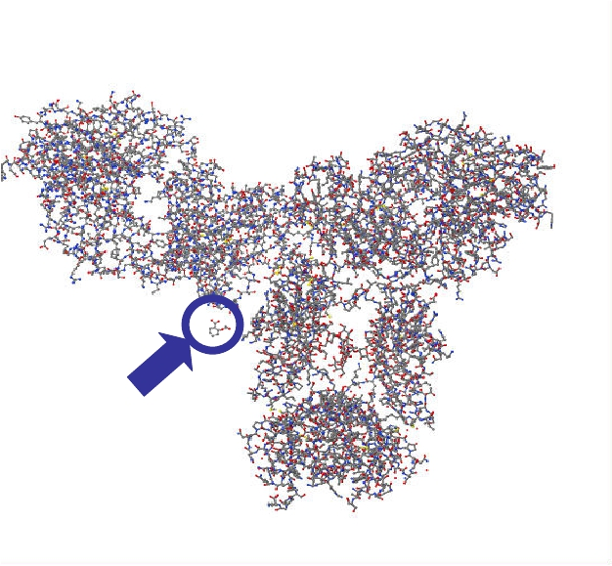
Small Molecule vs Biologic Drugs
Biological products are generally produced using a living system or organism
Biological products may be manufactured through biotechnology, derived from natural sources, or produced synthetically
Monoclonal
Antibody
Aspirin
Biosimilar Guidance Webinar February 15, 2012.

Slide 7
Biologics vs Small Molecule Drugs
Biologics have a complex manufacturing process
Multiple steps; proprietary processes
Alteration in processes by the originator requires validation of the product
Expected variation between manufacturers
Even small differences can result in a different end-product

Slide 8
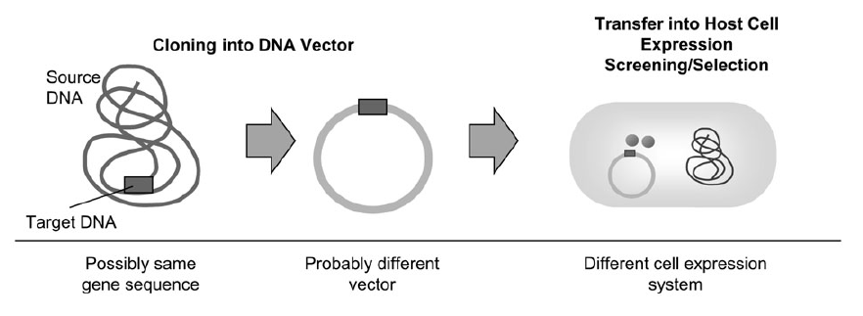
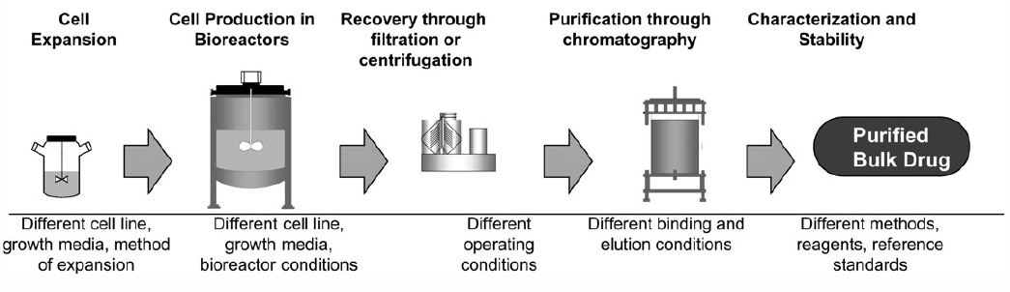
Manufacturing Biosimilars
Mellstedt H, et al. Ann Oncol. 2008;19(3):411-419.

Slide 9
What Is Acceptable Variation? Lot to Lot Variation of Innovator Products: Darbepoietin
Comparison of lots of darbepoietin by capillary zone electrophoresis pre- and post- EMA approved process change base on an extensive comparability exercise
Relative isoform content
Representative electropherograms
EMA, European Medicines Agency
Schiestl M, et al. Nat Biotechnol. 2011:29(4):310-312.

Slide 10
What Is Acceptable Variation? Lot to Lot Variation of Innovator Products: Rituximab
Cation Exchange Chromatography
Cation Exchange Chromatography
ADCC
Glycan Mapping
Significant change in ADCC and glycan map for unfucosylated G0 glycans (which impacts ADCC)
ADCC, Antibody-dependent cellular cytotoxicity
Schiestl M, et al. Nat Biotechnol. 2011:29(4):310-312.

Slide 11
What Is Acceptable Variation? Lot to Lot Variation of Innovator Products: Etanercept
Cation Exchange Chromatography
Glycan Mapping
Significant change in glycans and basic variants since in batches over time
Schiestl M, et al. Nat Biotechnol. 2011:29(4):310-312.

Slide 12
Biologics vs Small Molecule Drugs
Unlike generic small molecule drugs:
Biosimilars will not be identical to the reference product because of differences in manufacturing processes
We cannot determine if a biosimilar product is identical to the reference product
Therefore, we must use preclinical and clinical (ie, safety/efficacy) studies to demonstrate comparability

Slide 13
Biosimilars for Lymphoma: Rituximab as the Target Drug

Slide 14
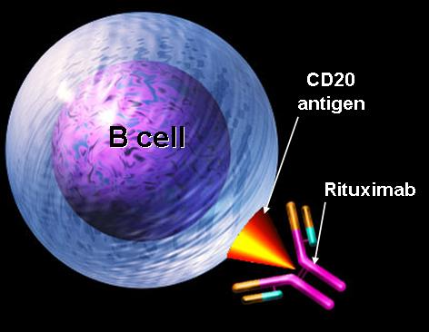
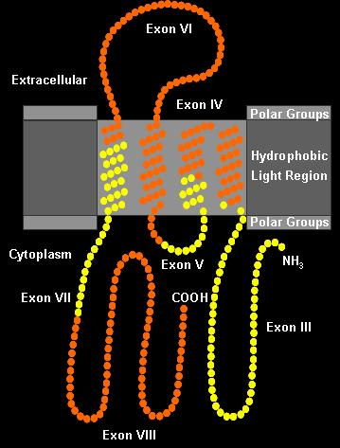
Rituximab for NHL
Rituximab
Chimeric molecule with a murine antigen binding domain
Human κ constant region
Human IgG1 constant region
CD20 antigen
Hydrophobic, 35 kD phosphoprotein
Expressed only on B lineage cells
Present in more than 90% of B-cell lymphomas
Important for cell cycle initiation and differentiation
Does not shed or rapidly modulate off cell surface
Notes:
Rituximab is approved for the treatment of patients with relapsed or refractory low-grade or follicular CD20+ B-cell lymphoma.¹
Chimeric mouse/human anti-CD20 MAb.
Human IgG1κ antibody with variable regions isolated from mouse anti-CD20 Mab.
Binding to CD20 triggers apoptosis in lymphoma cell and mediates ADCC and complement dependent cytotoxicity.¹
Mouse/human construct compared to pure murine antibody:
Less immunogenic
Long half-life:¹
59.8 hours (range 11.1 to 104.6 hours) after first dose
174 hours (range, 26 to 442 hours) after fourth dose
Optimal role of rituximab in treatment of low-grade NHL continues to be defined.
Standard regimen: 375 mg/m² once weekly for 4 weeks.¹
Rituxan® (Rituximab) [prescribing information]. South San Francisco, Ca: Genentech, Inc. 1997.

Slide 15
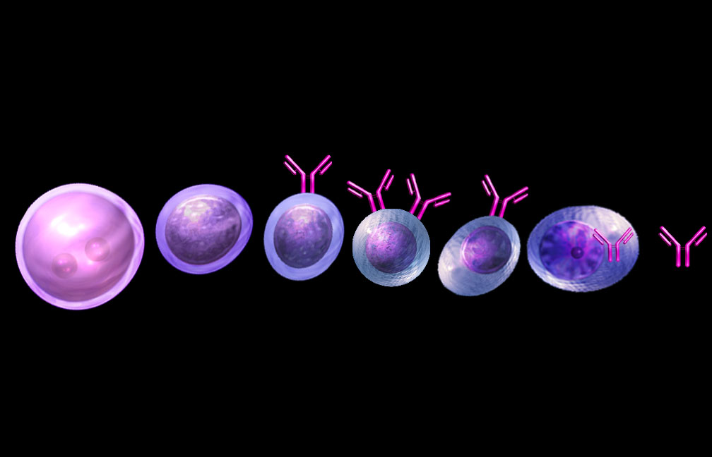
B-Cell Life Cycle and CD20 Tumor Specificity
Bone Marrow
Blood; Lymph
IgM
IgM
IgD
Ig
Pluripotent stem cell
Lymphoid stem cell
Activated B cell
Plasma cell
Pre-B cell
B cell
CD20 Antigen Expression
CML
Precursor B-cell acute leukemias
B-cell lymphomas, CLL
Myeloma
CLL, chronic lymphocytic leukemia; CML, chronic myeloid leukemia.
Notes:
CD20 is convenient target for antibody therapy, expressed in most but not all B-cell lymphomas, with some but not perfect specificity against lymphomas.
Target antigen should be as specific as possible to lymphoma to avoid binding of antibody to normal non-hematopoietic tissue or hematopoietic progenitor cells.
Like normal B cells, malignant B cells are characterized by expression of specific surface antigens according to their differentiation stage.
CD20 antigen:
Expressed in >90% of B-cell lymphomas and chronic lymphocytic leukemias, and 50% of pre-B cell acute lymphoblastic leukemias
Present on normal B cells from pre-B cell stage to the activated B cell stage
Not expressed on stem cells, plasma cells, or cells of other lineage
Does not circulate in plasma as free protein, which would compete with antibody binding to lymphoma cells¹
Anti-CD20 MAbs can be useful in treating lymphoma, but with limitations:
Not entirely specific against lymphoma
Not effective against minority of B-cell lymphomas that do not express CD20
Rituxan® (Rituximab) [prescribing information]. South San Francisco, Ca: Genentech, Inc. 1997.
Feuring-Buske M, Buske C, Unterhalt M, Hiddemann W. Recent advances in antigen-targeted therapy in non-Hodgkin’s lymphoma. Ann Hematol. 2000;79:167–174.

Slide 16

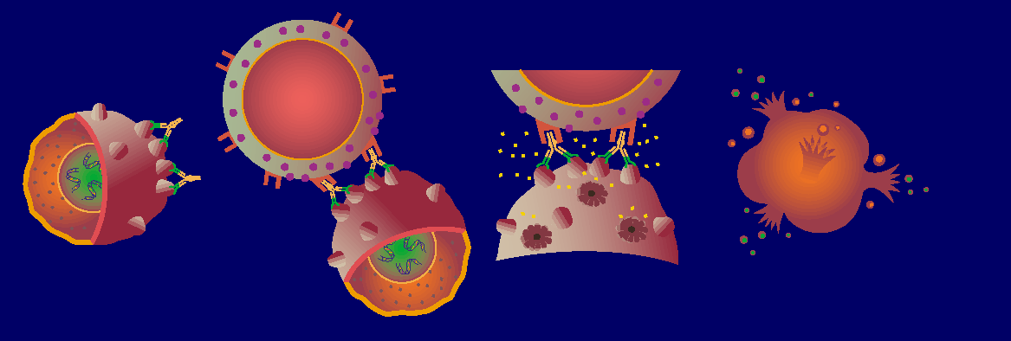

Rituximab: Proposed Mechanisms of Action (MOA)
CDC
ADCC
Apoptosis
CDC, complement-dependent cytotoxicity

Slide 17
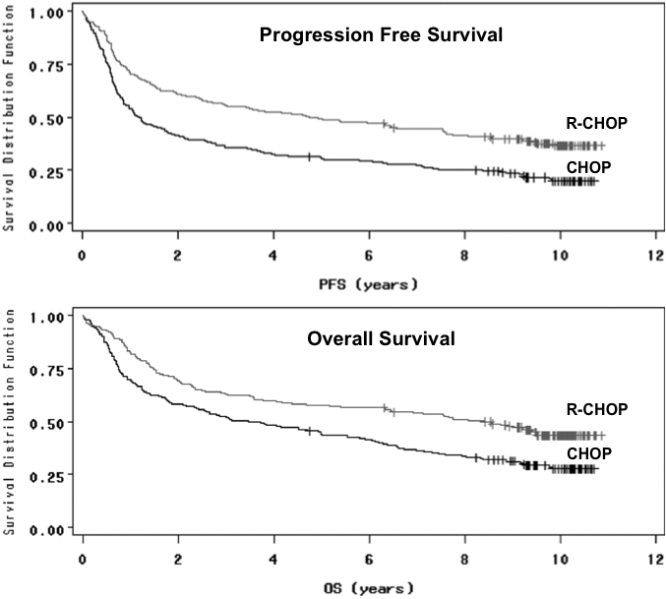
Rituximab in DLBCL: Addition of Rituximab to CHOP Improves Overall Survival (OS)
DLBCL, diffuse large B-cell leukemia
Coiffier B, et al. Blood. 2010;116(12):2040-2045.

Slide 18
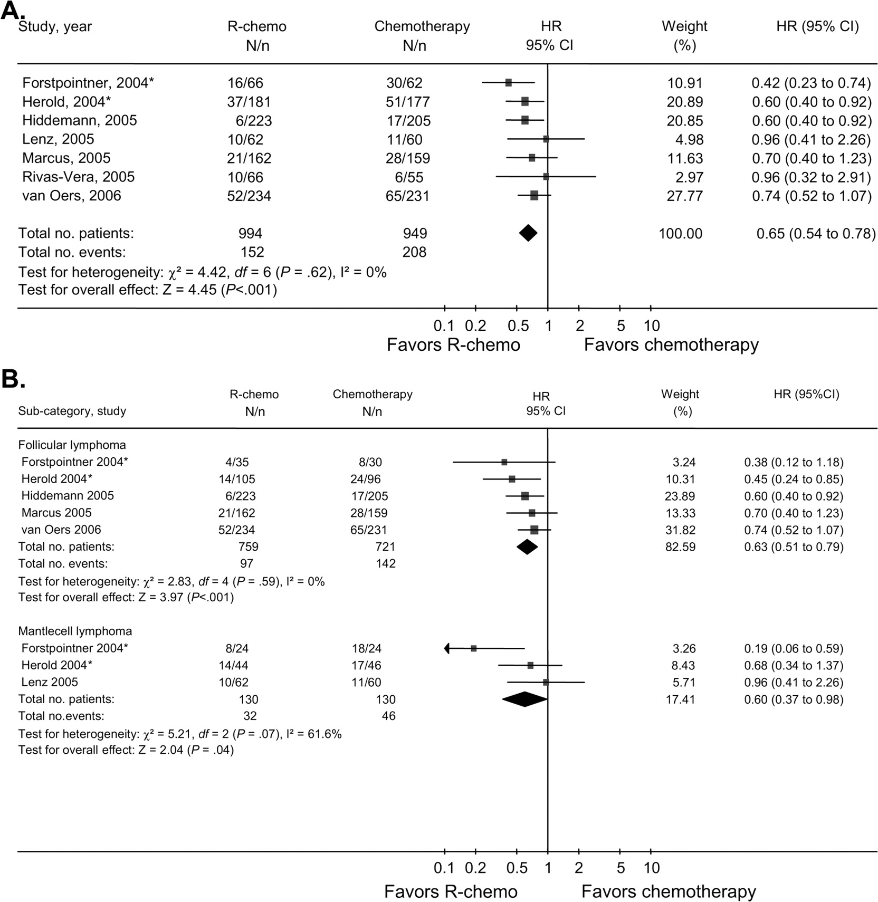
Rituximab in FL: Meta-Analysis Demonstrates an OS Advantage for R-Chemo vs Chemo Alone
Based on the results of this meta-analysis and the supporting phase III trials, rituximab in combination with chemotherapy is the STANDARD OF CARE patients requiring therapy (CATEGORY 1)
In these trials, PFS benefit is disproportionately large compare to the OS benefit
The optimal R-CHEMO regimen remains undefined.
FL, follicular lymphoma; PFS, progression-free survival
Schulz H, et al. J Natl Cancer Inst. 2007;99(9):706-714.
Notes:
Mary: for sentence Based on the results…. Changed last part of sentence to “…patients requiring” (removed extra patient)
Hema –Changed “Patient” to “Patients” in the title.
Meta-analysis of overall survival among patients who received rituximab with chemotherapy (R-chemo) or chemotherapy alone. Overall survival is shown as the hazard ratio (HR) for death from any cause. A) Overall survival for all patients with indolent or mantle cell lymphoma. B) Overall survival for the subgroups of patients with follicular lymphoma or mantle cell lymphoma. N = number of events; n = number of patients. Solid squares represent risk estimates for the single studies. The size of the squares represents the weight assigned to the individual study in the meta-analysis and is proportional to the inverse variance of the estimate. Horizontal lines indicate 95% confidence intervals (CIs). Wide confidence intervals were truncated with an arrow. The diamonds show the 95% confidence intervals for the pooled hazard ratios. Values less than 1.0 indicate hazard ratios that favor R-chemo. *Includes unpublished data provided by the investigators in October 2005.

Slide 19
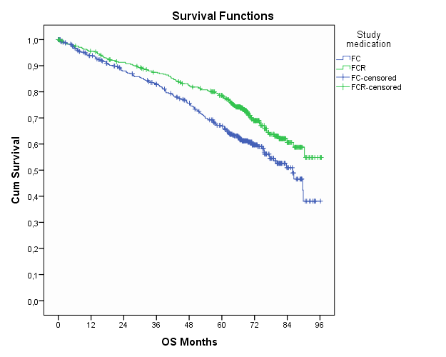
Rituximab in CLL: Addition of rituximab to FC Improves OS (CLL8)
FCR
FC
OS:
HR 0.678, P = .001
Median follow-up 69.97 months
Fischer K, et al. Blood. 2012;120: Abstract 435.

Slide 20
Do We Need a Biosimilar for Rituximab?
The typical dose of rituximab if 375 mg/m²
Estimated average wholesale price is $4000 per dose
Cost for
4-week induction: $16,000
2 years maintenance: $32,000
6 doses with R-CHOP: $24,000
These are average wholesale costs, not charges, which can be double this
Ex-US prices are not very much lower
Cost in countries like India and China are prohibitive
Cost limits availability and therefore compromises outcome

Slide 21
Development of Rituximab Biosimilars
Worldwide annual sale of rituximab are $7 billion US
Malignant conditions: B cell lymphoma
Benign conditions: Rheumatoid arthritis (RA)
EU Patent expiration: 2013
US Patent expiration: 2018
Many companies have launched efforts in rituximab biosimilars
Amgen (ABP 798)
Biocad (BCD-20) Approved in Russia 04/2014
Boehringer Ingelheim (BI 695500)
Hospira/Celltrion (CT-10)
Samsung (SAIT101)
Sandoz (GP2013)
Teva (TL011)

Slide 22




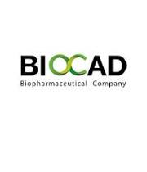



Development of rituximab biosimilars
Worldwide annual sale of rituximab are $7 billion US
Malignant conditions: B cell lymphoma
Benign conditions: Rheumatoid arthritis
EU Patent expiration: 2013
US Patent expiration: 2018
This has led many companies (both traditional innovators and generic companies) to launched efforts in rituximab biosimilars
Ongoing Development
Halted Development
(ABP 798)
(BI 695500)
(TL011)
(BCD-20)
(GP2013)
(CT-10)
(SAIT101)

Slide 23
How to Develop a Rituximab Biosimilar
Assume the preclinical evaluation is acceptable, what trials would convince me to use a biosimilar?
What is the MOA
Single agent: Antibody-dependent cell-mediated toxicity is probably the key, but contribution from complement-mediated cytotoxicity and some direct apoptosis
Chemoimmunotherapy: Chemotherapy sensitization of tumor cells is likely important in addition to the immune effects

Slide 24
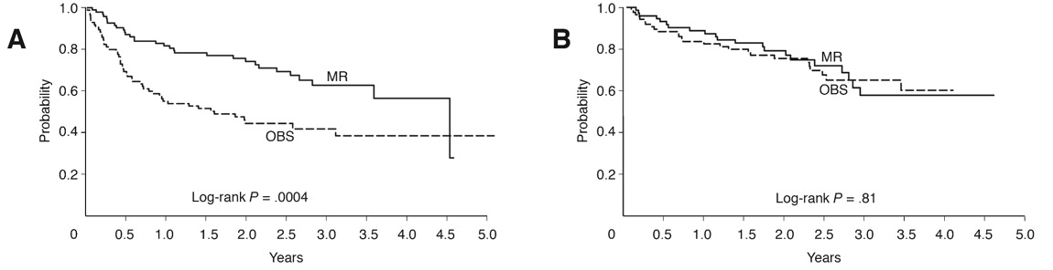
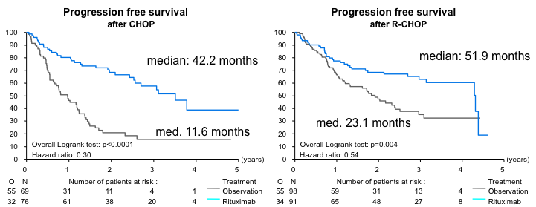
Rituximab/Chemotherapy: Is There Synergy?
ECOG 4494/CALG 9793: DLBCL¹
CHOP➡R
R-CHOP
EORTC 20981: FL²
CHOP➡R
R-CHOP
Habermann TM, et al. J Clin Oncol. 2006;24(19):3121-3127.
Van Oers MH, et al. J Clin Oncol. 2010;28(17):2853-2858.
Notes:
Failure-free survival (FFS) and overall survival (OS) according to maintenance rituximab (MR) therapy or observation (OBS) by induction treatment. MR significantly prolonged FFS after (A) cyclophosphamide, doxorubicin, vincristine, and prednisone (CHOP) but not after (B) rituximab with CHOP (R-CHOP). No significant differences were observed in OS after (C) CHOP (hazard ratio [HR] = 0.73; 95% CI, 0.43 to 1.27; P = .27) or (D) R-CHOP (HR = 1.28; 95% CI, 0.65 to 2.53; P = .48).

Slide 25
How to Develop a Rituximab Biosimilar
Single agent
Most sensitive population: Single-agent rituximab in untreated FL
Problem: Rituximab not approved in this population!
Alternative: Rituximab vs biosimilar in patients with relapsed FL
Problem: Little use in the population today
How can we get the study done?
Chemoimmunotherapy
Most sensitive population: Diffuse large B-cell lymphoma
Two-sided equivalence study would be ~600 patients
What would be the motivation for a patient to participate?

Slide 26
Rituximab Biosimilar Trials (Partial List)
Title: Study of RTXM83 Plus CHOP Chemotherapy Versus a Rituximab Plus CHOP Therapy in Patients With Non Hodgkin's Lymphoma
Conditions: Diffuse Large B-cell Lymphoma
Interventions: Biological: RTXM83
URL: http://ClinicalTrials.gov/show/NCT02268045
Title: GP2013 in the Treatment of Patients With Previously Untreated, Advanced Stage Follicular Lymphoma
Conditions: Follicular Lymphoma
Interventions: Biological: GP2013|Biological: rituximab
URL: http://ClinicalTrials.gov/show/NCT01419665
Title: Demonstrate the Equivalence of CT-P10 to MabThera With Respect to the Pharmacokinetic Profile in Patients With Rheumatoid Arthritis
Conditions: Rheumatoid Arthritis
Interventions: Biological: rituximab
URL: http://ClinicalTrials.gov/show/NCT01534884
Title: Provide Initial Evidence of Safety, Pharmacokinetics, Pharmacodynamics, and Efficacy to Support the Pivotal CT-P10 Therapeutic Equivalence Trial
Conditions: Diffuse Large B-Cell Lymphoma
Interventions: Biological: rituximab
URL: http://ClinicalTrials.gov/show/NCT01534949
Title: Study of Safety and Efficacy of BCD-020 Comparing to MabThera in Patients With Rheumatoid Arthritis
Conditions: Rheumatoid Arthritis
Interventions: Drug: Rituximab
URL: http://ClinicalTrials.gov/show/NCT01759030

Slide 27
Rituximab Biosimilar Trials (Partial List)
Title: Pharmacokinetics and Pharmacodynamics of BI 695500 vs. Rituximab as First Line-treatment in Patients With Low Tumor Burden Lymphoma
Conditions: Lymphoma, Follicular
Interventions: Drug: BI 695500|Drug: MabThera
URL: http://ClinicalTrials.gov/show/NCT01950273
Title: Efficacy, Pharmacokinetics, and Safety of BI 695500 in Patients With Rheumatoid Arthritis
Conditions: Arthritis, Rheumatoid
Interventions: Drug: BI 695500|Drug: BI 695500|Drug: rituximab|Drug: rituximab|Drug: rituximab
URL: http://ClinicalTrials.gov/show/NCT01682512
Title: Safety and Efficacy of BI 695500 in Patients With Moderately to Severely Active Rheumatoid Arthritis
Conditions: Arthritis, Rheumatoid
Interventions: Drug: BI 695500
URL: http://ClinicalTrials.gov/show/NCT01955733
Title: Safety and Efficacy Study of BCD-020 in Therapy of Non-Hodgkin's Lymphoma
Conditions: Follicular Non-Hodgkin's Lymphoma|Nodal Marginal Zone Lymphoma|Splenic Marginal Zone Lymphoma
Interventions: Biological: rituximab
URL: http://ClinicalTrials.gov/show/NCT01701232
Title: Study of Safety and Efficacy of BCD-020 Comparing to MabThera in Patients With Rheumatoid Arthritis
Conditions: Rheumatoid Arthritis
Interventions: Drug: Rituximab
URL: http://ClinicalTrials.gov/show/NCT01759030

Slide 28
Rituximab Biosimilar Trials (Partial List)
Title: GP2013 in Japanese Patients With CD20 Positive Low Tumor Burden Indolent B-cell Non-Hodgkin's Lymphoma
Conditions: Indolent B-cell Non-Hodgkin's Lymphoma
Interventions: Drug: GP2013
URL: http://ClinicalTrials.gov/show/NCT01933516
Title: GP2013 in the Treatment of RA Patients Refractory to or Intolerant of Standard Therapy
Conditions: Rheumatoid Arthritis
Interventions: Biological: GP2013|Biological: rituximab
URL: http://ClinicalTrials.gov/show/NCT01274182

Slide 29
Extrapolation in Rituximab
From “Biosimilars: what clinicians should know”1
“Extrapolation of efficacy and safety data to other indications of the reference product that have not been investigated during the clinical development of the biosimilar always requires convincing scientific justification, which should address the mechanism of action, toxicities, and immunogenicity in each indication of use.”
With a rituximab biosimilar can we extrapolate:
From non-malignant use (eg, RA) to lymphoma?
From use in lymphoma to autoimmune disease?
From single agent to combination?
From combination to single agent?
¹Weise M, et al. Blood. 2012;120(26):5111-5117.

Slide 30
Challenges to the deployment of biosimilar rituximab
Uses of rituximab
Addition of rituximab to curative intent regimens, examples include: R-CHOP; DA-EPCOH-R for DLBCL; R-CODOX-M/R-IVAC for BL
Addition of rituximab to improve outcome but with high risk of recurrence, examples include R-CVP, R-CHOP, R-bendamustine for indolent lymphoma, R-Flu, FCR for CLL
Extended administration of rituximab as maintenance in indolent lymphoma
Rituximab single agent as palliation in B cell lymphoma
In non-curative settings (or relapse in curative settings) RETREATMENT with rituximab is nearly universal
How do these considerations impact a biosimilar?

Slide 31
What we need to know
Immunogenicity
Does order of exposure impact the risk of an immune reaction?
In the absence of documented interchangeability is it safe
To use a biosimilar for relapse if rituximab was used initially (and vice versa)?
To use different agents during maintenance therapy?
What happens when patients receive care from more than one provider (“snow birds” for instance)?

Slide 32
Conclusions
Biologic drugs have become the centerpiece of clinical care in oncology
Biologics are complex drug than cannot be made “generic”
Biosimilars are inherently different drugs but may not be clinically meaningfully different
FDA and EMA have provided guidance for the development and approval of biosimilars
Rituximab as a case study is a clear target for biosimilar development
Hurdle is identifying appropriate patients and trials to provide the clinical basis for safety and efficacy
Practical issues in deployment when interchangeability is not established
What is the pharmacovigilance required?

